Slide 1
Mobile Device IoT using Blynk
Frank Walsh

Slide 2
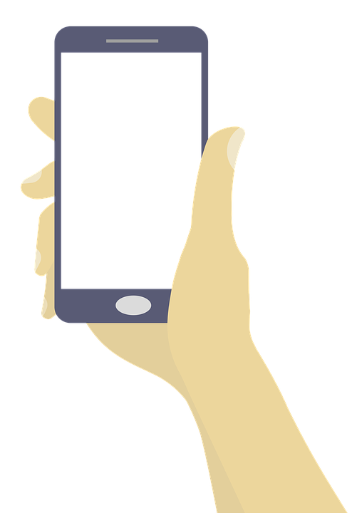
Mobile Devices and IoT
Critical component of many IoT solutions is the mobile phone/tablet.
  IOS/Android dominate
>2.6 billion users worldwide
  Simple, mobile connection to the internet
Provides nice features for IoT apps
  Packed with sensors (Location, accelerometer, camera)
  Can connect/interlink other smart devices using Bluetooth, BLE, etc.

Slide 3
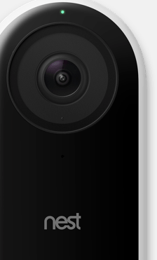
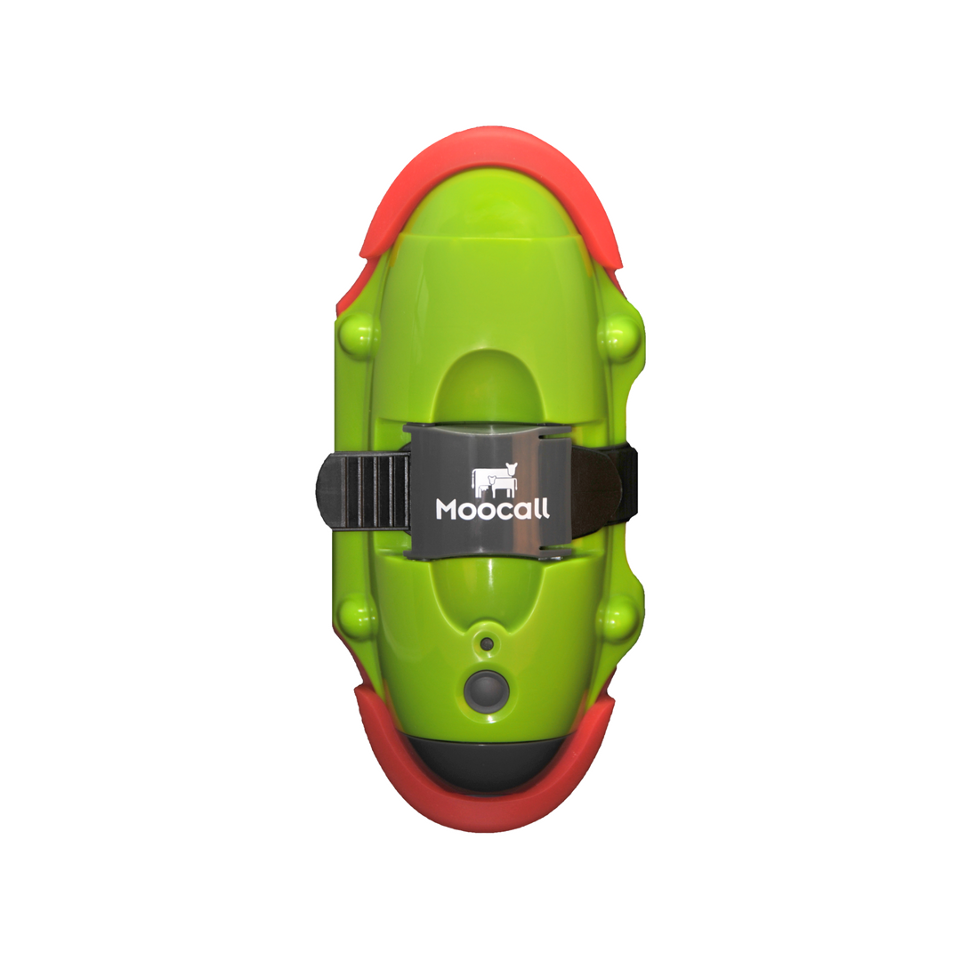
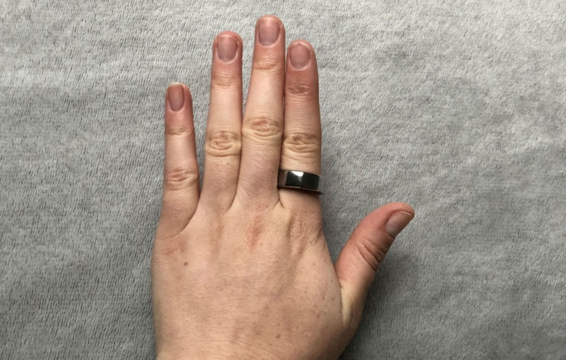
Mobile Apps in IoT, Examples
Wearables
  wristwatches, eyeglasses and rings
Healthcare
  Medical sensors obtain health data and transfer to a mobile app.
  This data can be transferred remotely to doctor/ family members
SmartHome
  Nest – see who’s at the door...
AgriTech
  MooCall

Slide 4
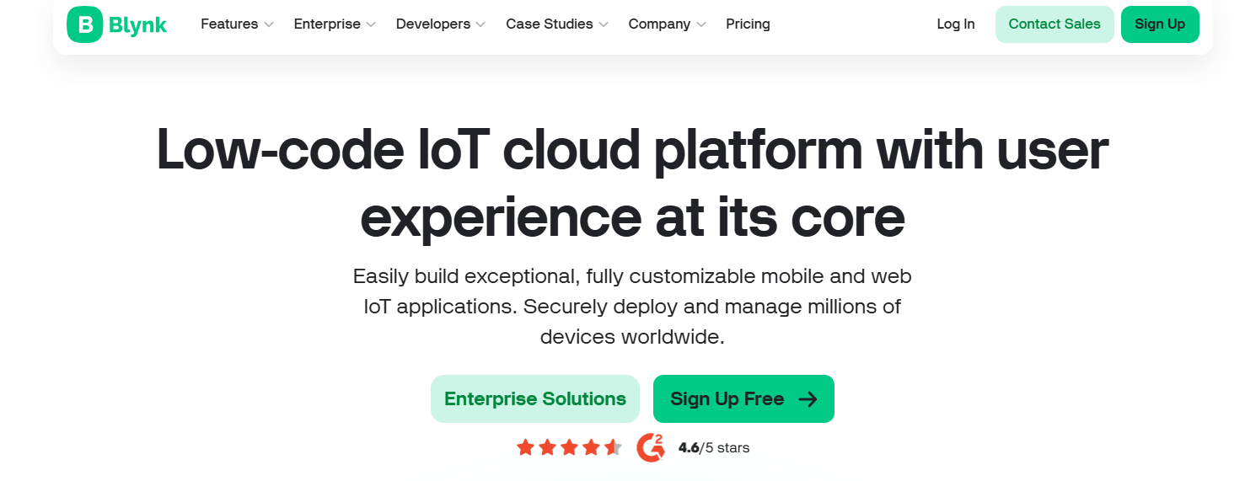

Slide 5

What's Blynk
Yet Another IoT Platform
  Specialism: mobile application builder
"Blynk is a full suite of software required to prototype, deploy, and remotely manage connected electronic devices at any scale: from personal IoT projects to millions of commercial connected products."

Slide 6
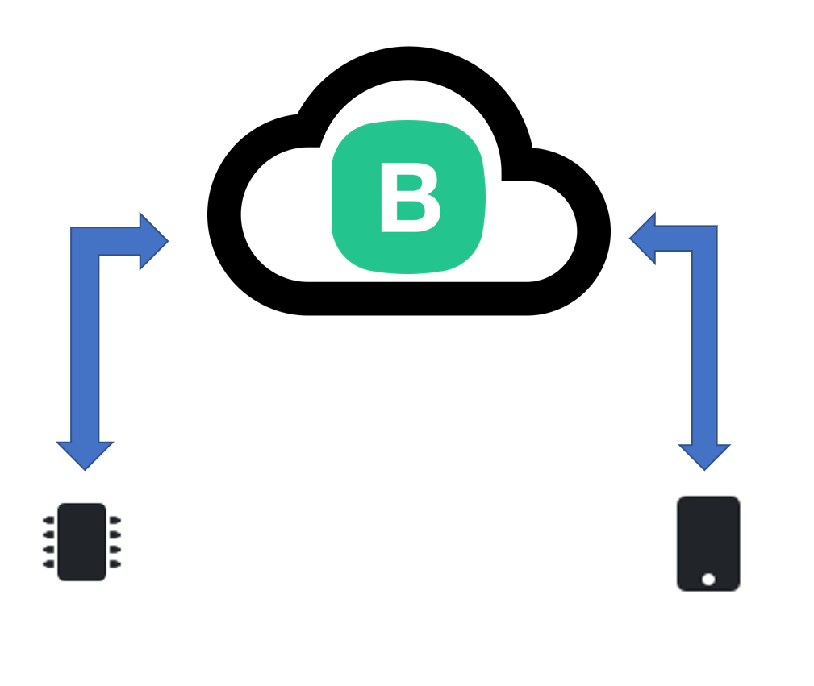


Platform Overview
4 Compnents
  Blink.Cloud
  Blynk.App
  Blynk.Console
  Blynk.Edgent
  (Device Libraries)

Slide 7
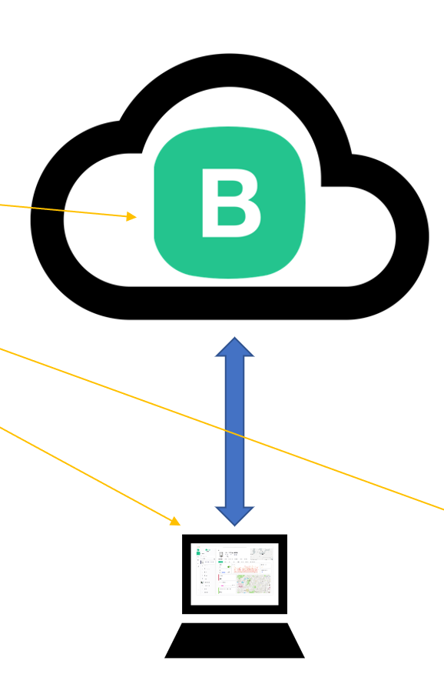
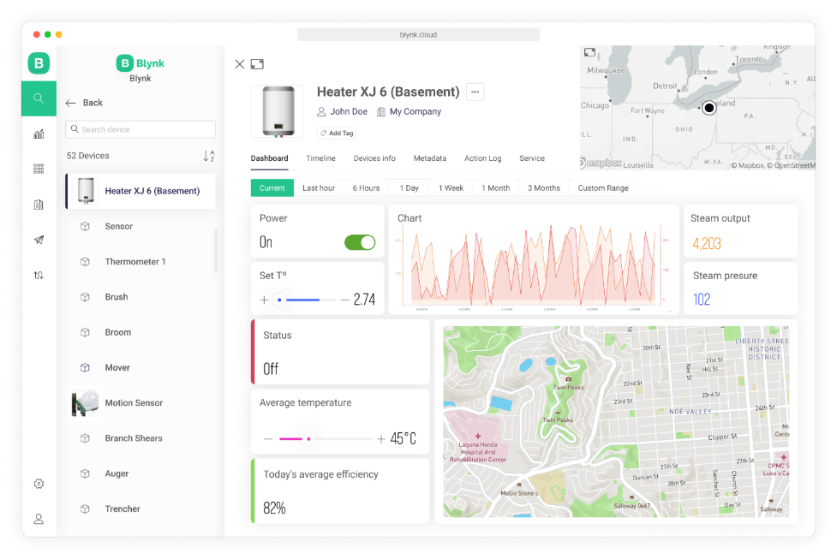
Blynk.Console
Blynk.Console is a feature-rich web application
Register with Blynk to gain access
Use it to:
  Configuration of how connected devices work on the platform + application settings.
  Management of devices, their data, users, organizations and locations
  Remote monitoring and control of devices

Slide 8
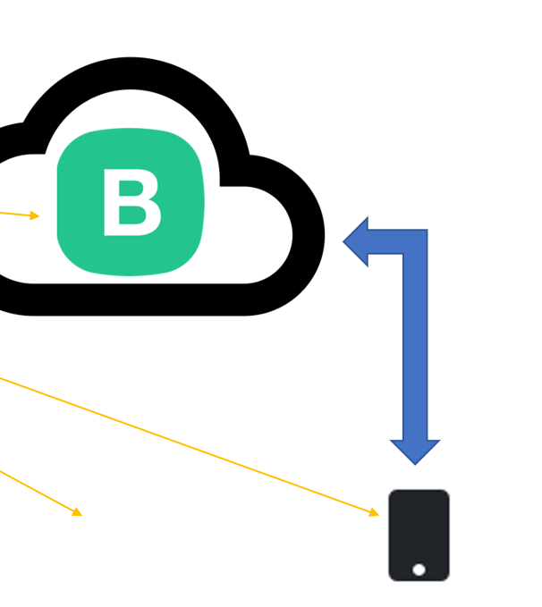
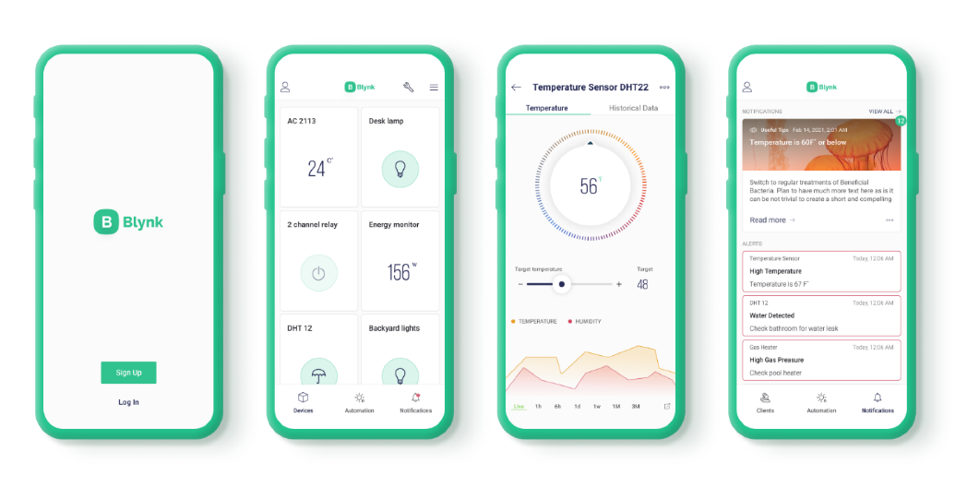
Blynk.App
Blynk.Apps is a multi-functional native iOS and Android mobile application
Use it to:
  Remote monitoring and control of connected devices that work with Blynk platform
  Configuration of mobile UI during prototyping and production stages
  Automate work of connected devices
Allows you to create mobile applications using drag and drop
  Uses "widgets"
No Code!!!
  Don't worry – that comes later

Slide 9
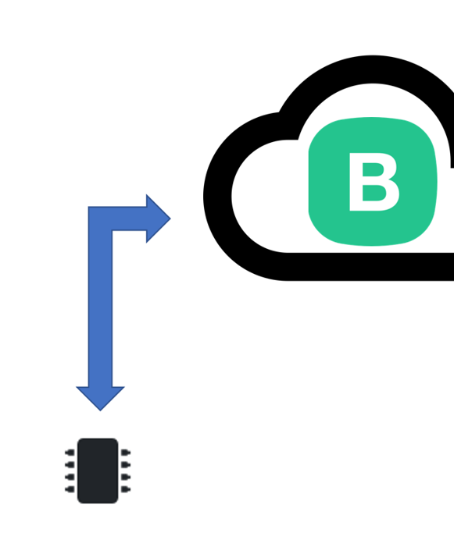
Blynk.Edgent(Device Library)
Lightweight embedded library that runs on over 400 supported hardware models
Use it to:
  bring your device online and authenticating)
  Connectivity management (WiFi, Cellular, Ethernet)
  Data transfer Over-the-air firmware updates (for selected hardware models)
Available for most popular hardware platforms
  RPi, Arduino, ...
Enable communication between the device and cloud API to work with specific Blynk.Apps and Blynk.cloud features
Python, Javascript, C++ … on the RPi.

Slide 10
Blynk.cloud
Blynk.Cloud is a server infrastructure – heart of Blynk IoT platform. Cloud is responsible for binding all the platform components together.
Controls all the communications between the mobile device(e.g. your phone) and hardware (e.g. the RPi)
Remember we talked about the benefits of indirect communication.
It's Cloud-based but you can run your own private Blynk Server
A bit like MQTT...(actually, after peeking at the source code, it uses the same MQTT libraries from the previous lab!)

Slide 11

Benefits
Don’t need to be a mobile app developer
Minimal code
Reasonably mature (around since 2014)
Very quick to create a prototype
If you want, process to publish to App store/Google Play
This Photo by Unknown Author is licensed under CC BY-SA-NC

Slide 12
Features
Similar API & UI for all supported hardware & devices
Connections/ Protocols:
WiFi
Bluetooth and BLE
Ethernet
USB (Serial)
GSM
…
Set of easy-to-use Widgets
Connect device with no code writing
Easy to integrate and add new functionality using virtual pins
History data monitoring via SuperChart widget
Device-to-Device communication using Bridge Widget
Sending emails, tweets, push notifications,

Slide 13
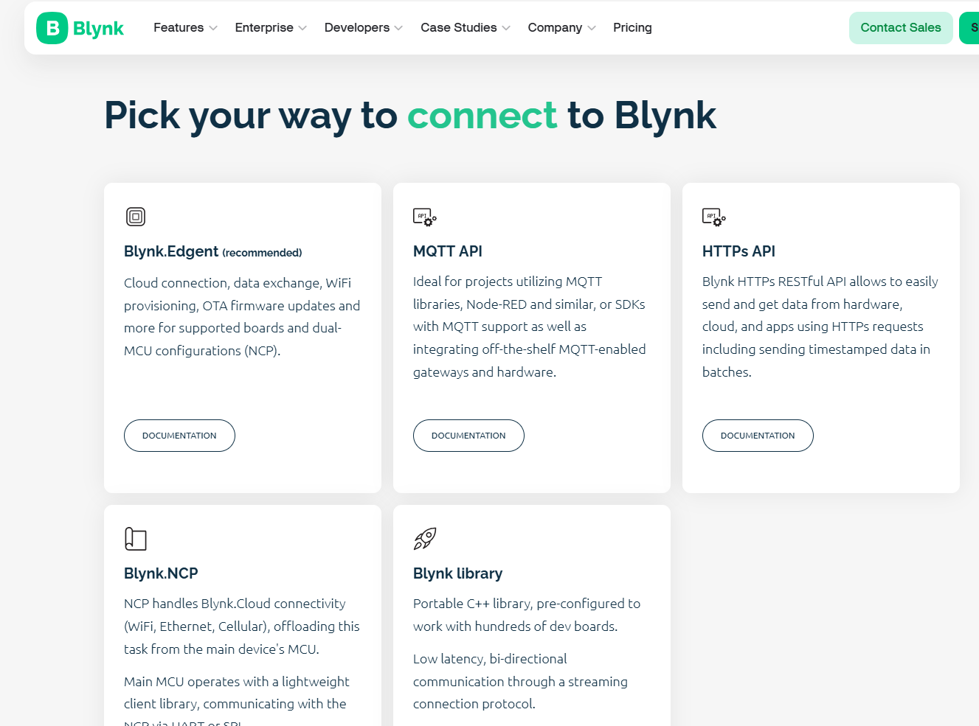

Slide 14
Blynk Concepts
Devices
Templates
Events
Dashboards

Slide 15
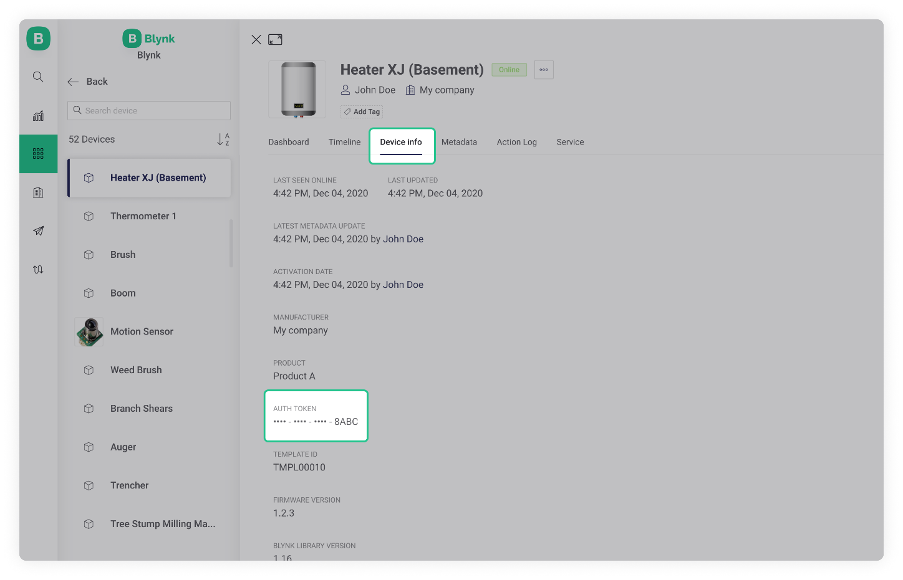
Blynk Concepts: Device
A “device” can be:
  A small MicroController based hardware (e.g. Arduino, Raspberry Pi, etc)
  A finished physical product like a Smart Air Conditioner, or a virtual service that sends data to Blynk.Cloud using REST API.
Each device has an “Authentication Token”. This is a unique identifier generated in Blynk.Cloud
Every device uses a Device Template.

Slide 16
Blynk Concepts: Device Template
A Device Template is a set of configurations used by similar devices.
A device template specifies:
  General Settings: general settings of the device(name, ID etc..)
  Metadata: a table of key:value data attached to every device. For example Serial Number field, email field to use for email notifications
  Datastreams: channels for any time-stamped data that flows in and out from the device to the cloud. For example sensor data should go through a Datastream. These are also known as “Virtual Pins”.
  Events: important events in the life of the device that should be logged and, if needed, used for notifications. Events can be triggered from the device itself or externally using HTTP API
  Dashboards: Set of UI elements to visualise data and send commands/data to/from device
    There are two dashboards: Web and Mobile

Slide 17
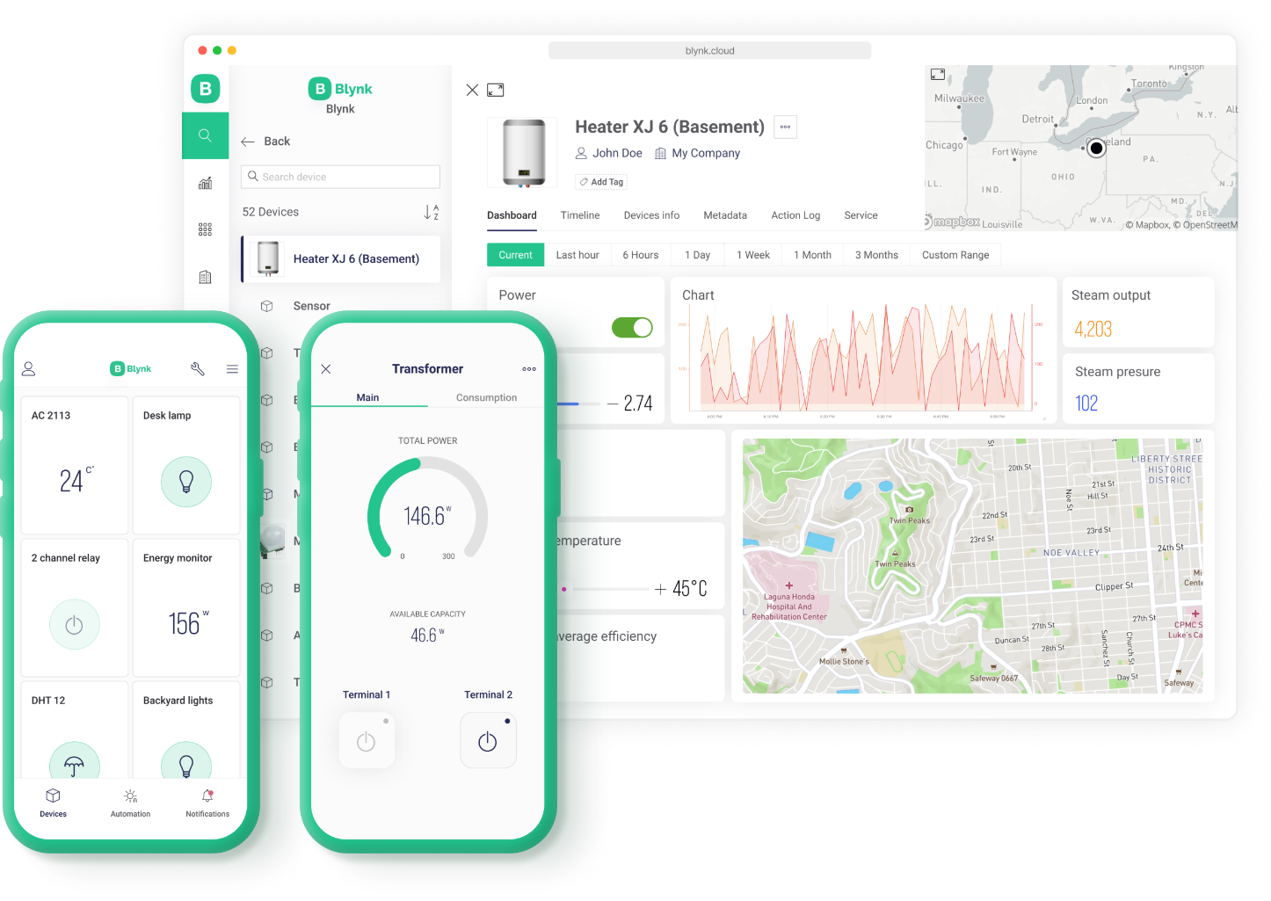

Blynk Concepts: Web Dashboard
a set of UI elements (widgets) to visualize the data from the device accessible for the users in Blynk.Console – a web-based application.

Slide 18

Blynk Concepts: Mobile Dashboard
a set of UI elements (widgets) to visualize the data in Blynk mobile apps for iOS and Android.
Mobile apps also contain a template of how device is represented in the list of devices (tiles)

Slide 19
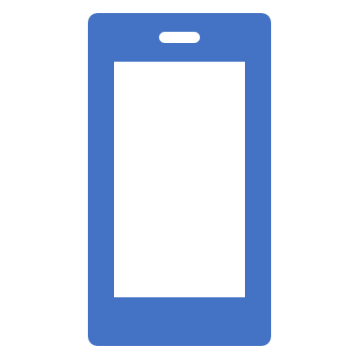
Development Steps
Create an Account with Blynk
Add a Device
  Choose your hardware
  Create “Template”
  This will result in an Authentication Credentials for that Device
Code the Hardware Device(e.g. Rpi)
Use the relevant library(e.g. Python Library)
Install Blynk App on Phone
  Develop Blynk

Slide 20
Add a Device
Create a new device
Set Notifications:
  Specify who gets notifications, which events will trigger notifications, and which channel should be used.
  3 options:
    E-mail
    Push notifications - a push notification is a message that pops up on a mobile device. Users don't have to be in the app to get them
    SMS - notification will be delivered as a text message using mobile operator (only available in paid option though…)

Slide 21
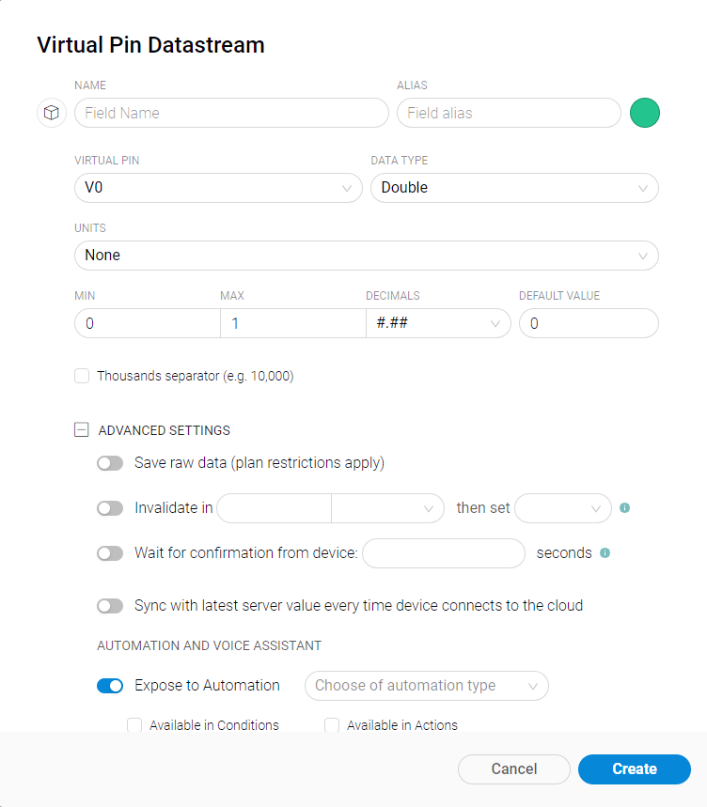
Working with Templates
Datastreams is a way to structure data that regularly flows in an out from device.
Use it for sensor data, any telemetry, or actuators.
Virtual Pin is a concept invented to provide exchange of any data between hardware, web and mobile app.
Virtual pins allow you to interface with any sensor, any library, any actuator.Think about Virtual Pins as a box where you can put any value, and everyone who has access to this box can see this value.
You can set UNITS that will be viewed in the Widget by selecting them from the dropdown menu.
It's a very powerful feature to display and send any data from your hardware to the application.Please make sure you differentiate Virtual Pins from physical GPIO pins on your hardware.

Slide 22
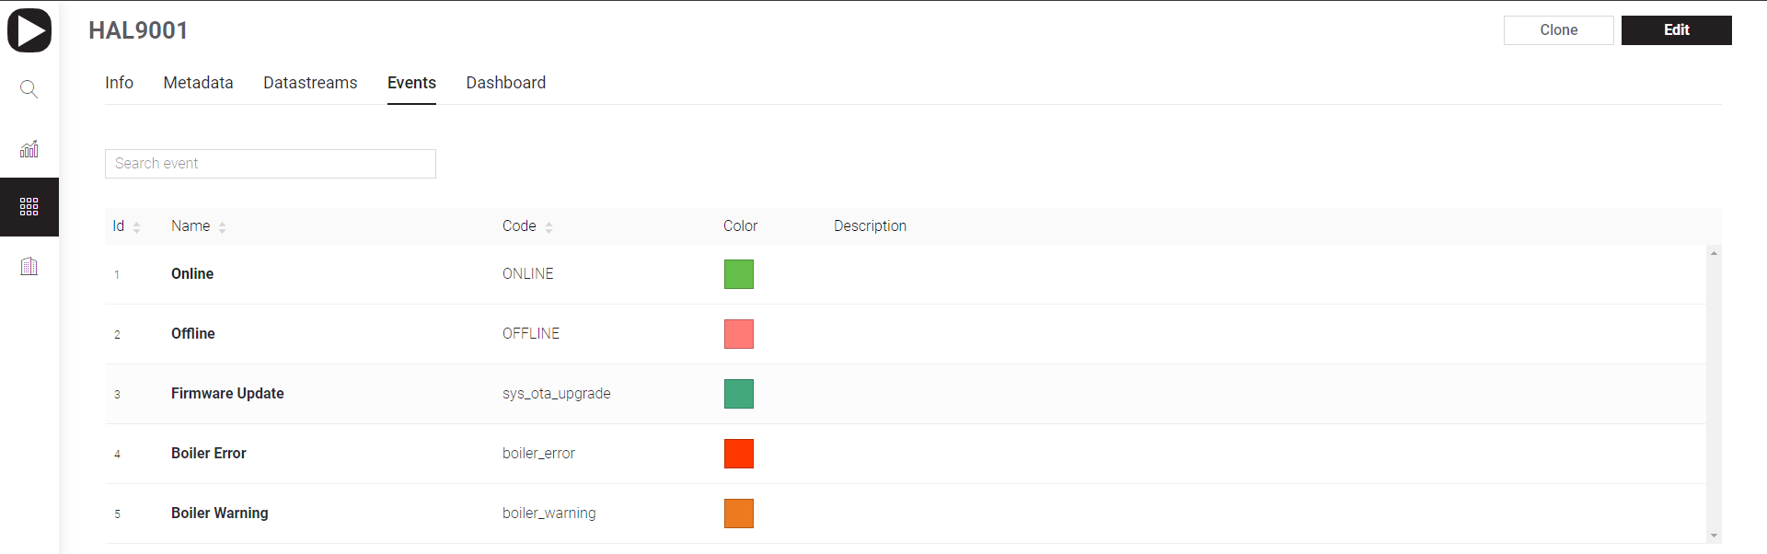
Working with Templates: Events
Events are used to track important events happening on your devices.
Events can trigger notifications which can be
  sent over email
  delivered as push notifications to user’s phone
  SMS
Examples:
  log a moment when a temperature reached a certain threshold and send a notification to selected users
  You need to log a total working hours of the device. If it approaches or goes beyond a max value, you would need to notify technical support so that they can replace the device

Slide 23
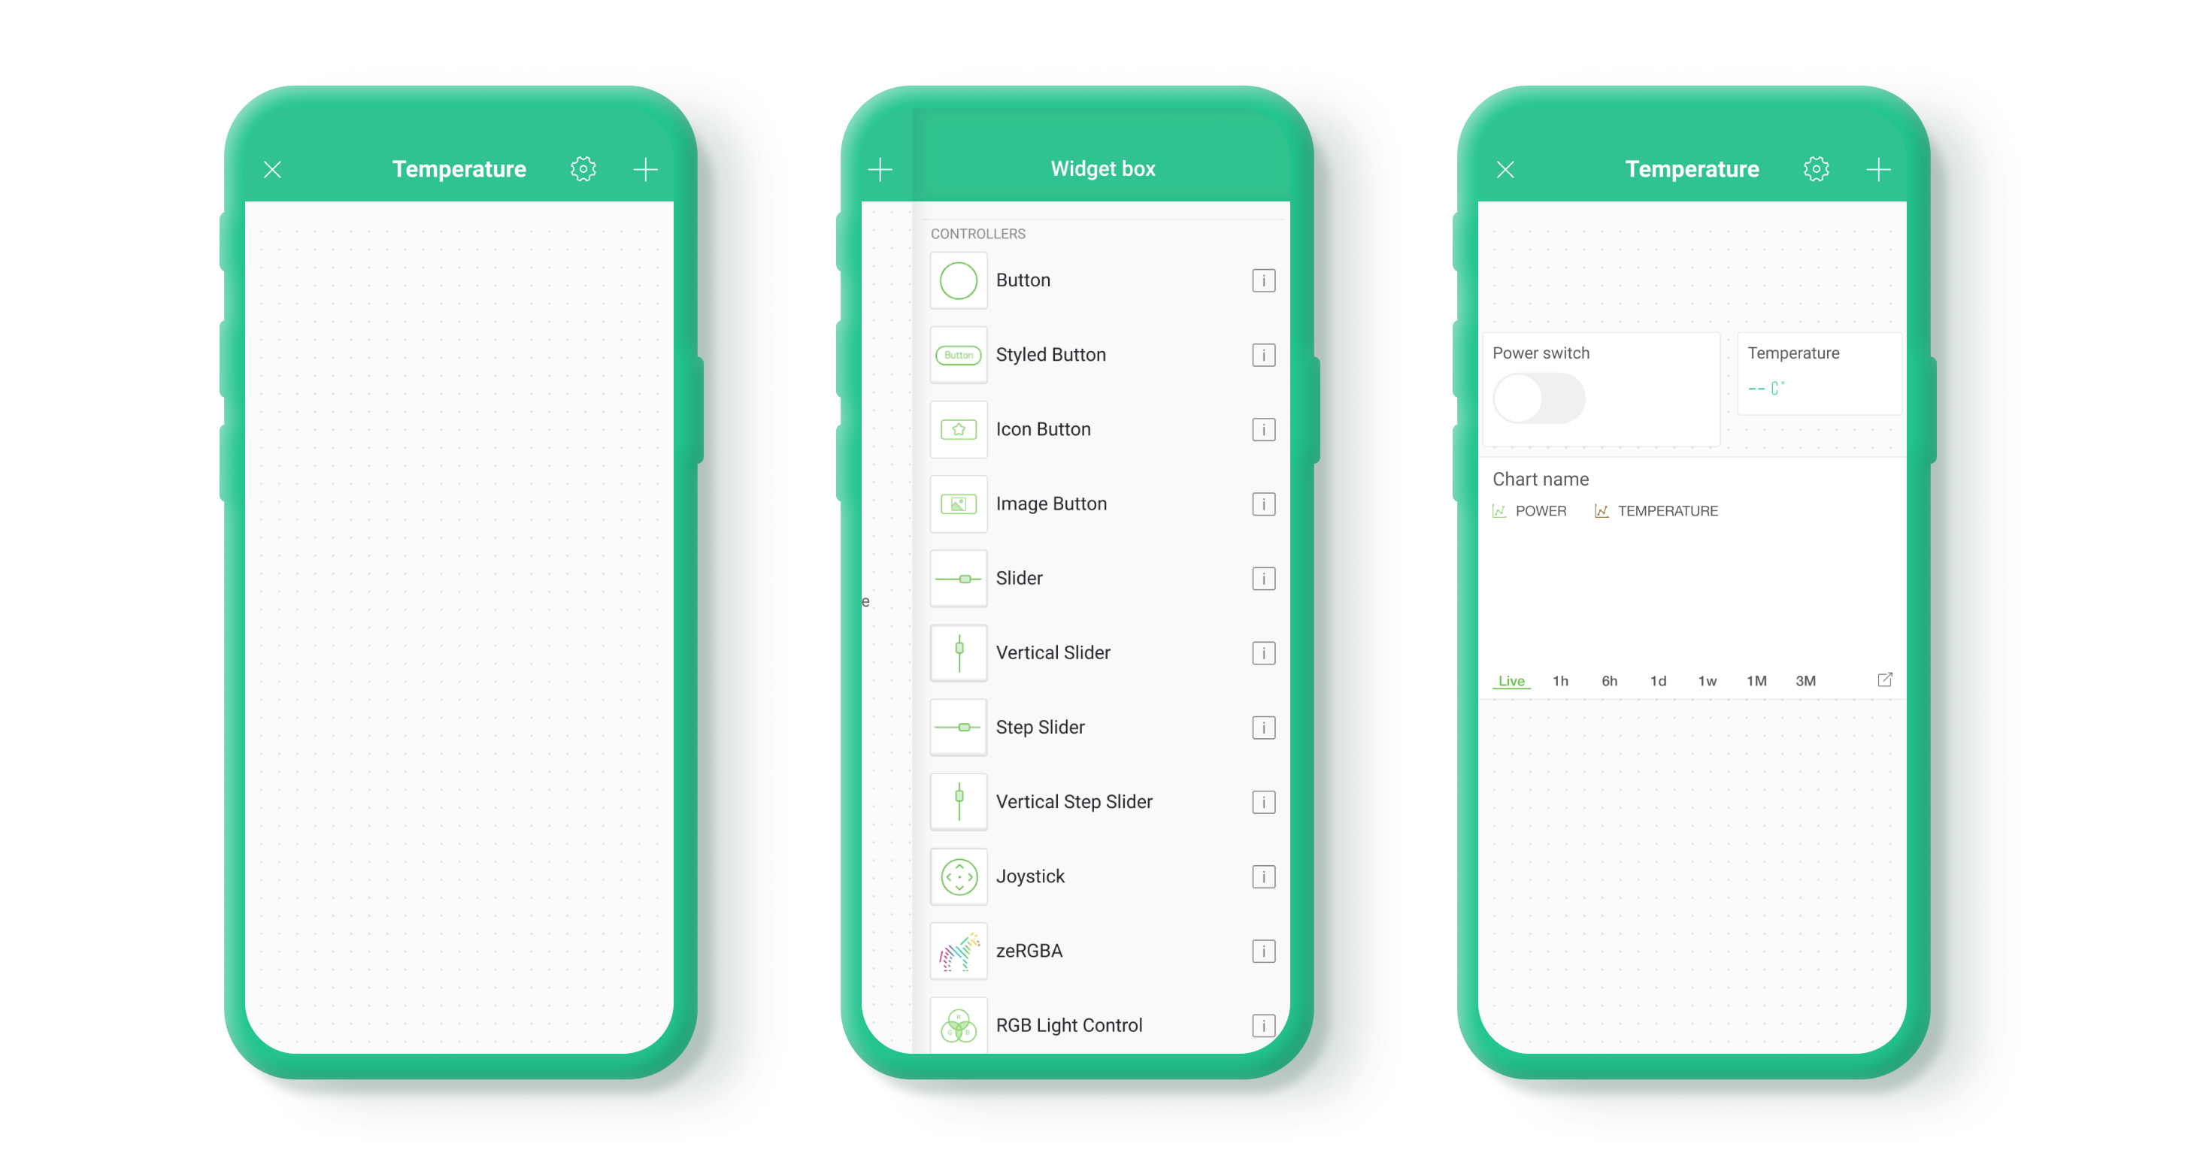

Blynk.Apps
Using the Blynk App, a Mobile Dashboard can be built from Widgets - modular UI elements which can be positioned on the canvas.
To add Widgets to Canvas:
  tap anywhere on empty canvas or press PLUS icon in the top right corner of the app.
  A Widget Box will open
  Find the widget you need and tap on it
  Widget will placed in the first empty area required for this widget
  Configure Widget.

Slide 24





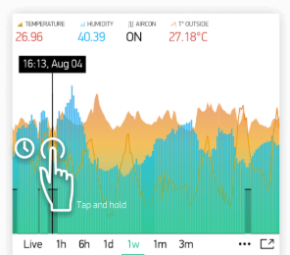


Widgets
Categorised as:
  Controllers
  Display
  Notifications
  Interface
    Tabs, Menu, Map..

Slide 25




Example
DEMO!!!!!

